Slide 1
Python Exception Handling - Try, Except and Finally
Week 6

Slide 2
What are exceptions in Python?
Python has many built-in exceptions which forces your program to output an error when something in it goes wrong.
When these exceptions occur, it causes the current process to stop and passes it to the calling process until it is handled.
If not handled, our program will crash.

Slide 3
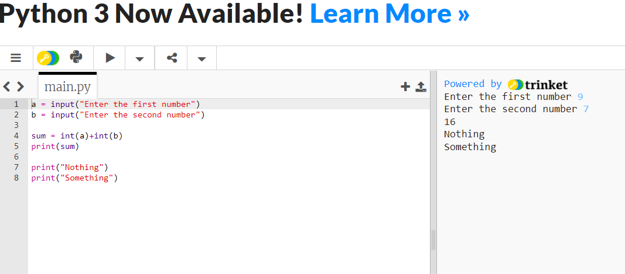
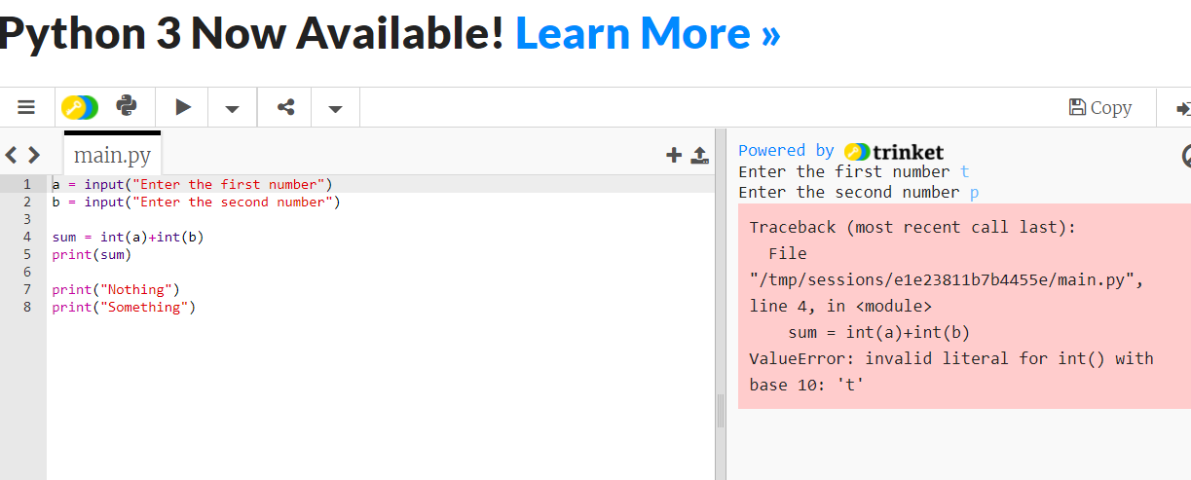

Slide 4
Python try...except Block
The try...except block is used to handle exceptions in Python.
Here's the syntax of try...except block:
try:
# code that may cause exception
except:
# code to run when exception occurs
Here, we have placed the code that might generate an exception inside the try block.
Every try block is followed by an except block.
When an exception occurs, it is caught by the except block. The except block cannot be used without the try block.

Slide 5
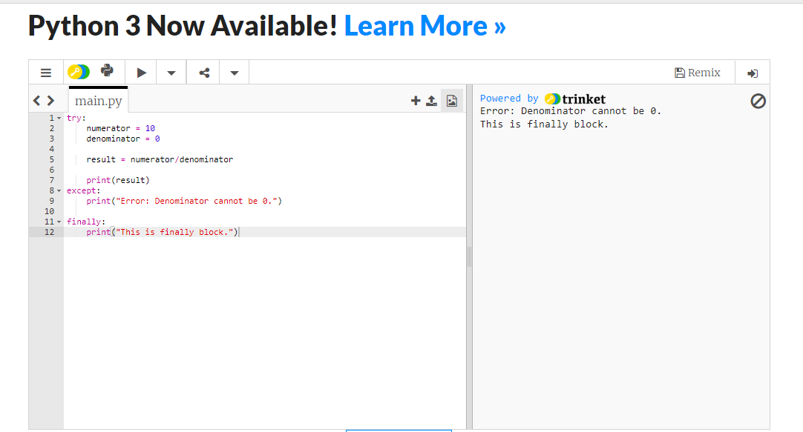
Python try...finally
In Python, the finally block is always executed no matter whether there is an exception or not.
The finally block is optional. And, for each try block, there can be only one finally block.

Slide 6
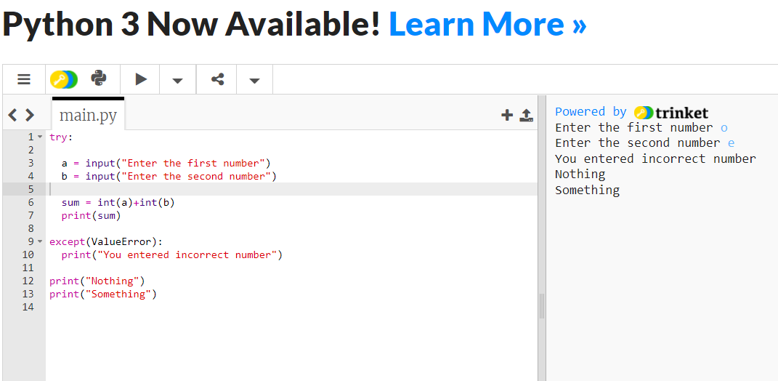

Slide 7
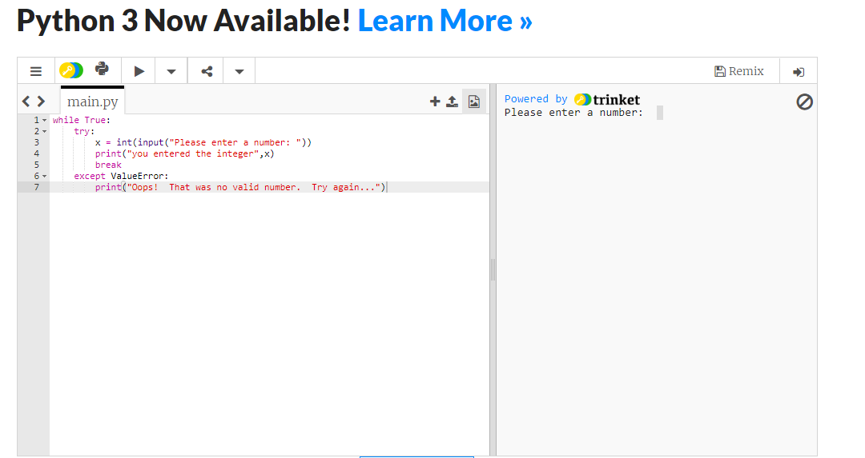
Look at the following example, which asks the user for input until a valid integer has been entered but allows the user to interrupt the program.

Slide 8
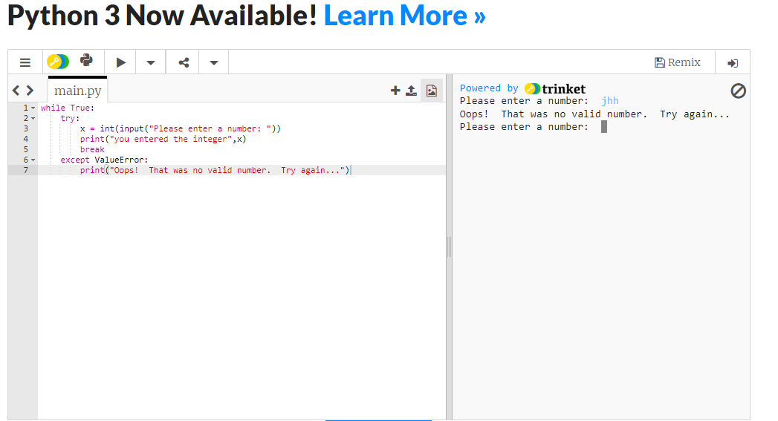

Slide 9
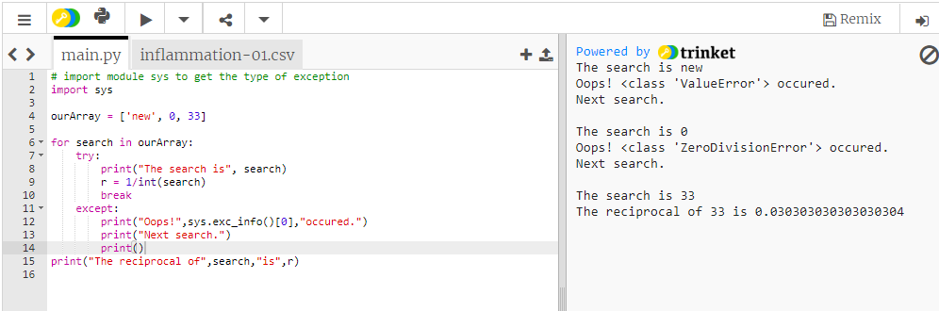
Catching Exceptions in Python
In Python, exceptions can be handled using a try statement.
A critical operation which can raise exception is placed inside the try clause and the code that handles exception is written in except clause.
It is up to us, what operations we perform once we have caught the exception.

Slide 10
Catching Specific Exceptions in Python
In the above example, we did not mention any exception in the except clause.
This is not a good programming practice as it will catch all exceptions and handle every case in the same way. We can specify which exceptions an except clause will catch.
A try clause can have any number of except clause to handle them differently but only one will be executed in case an exception occurs.

Slide 11
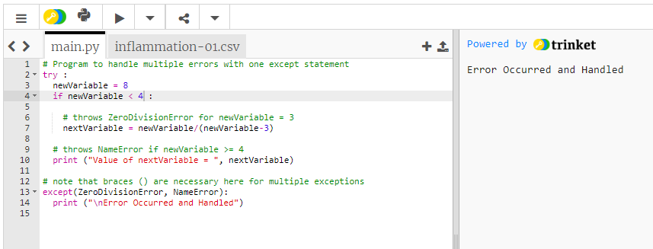
Example

Slide 12
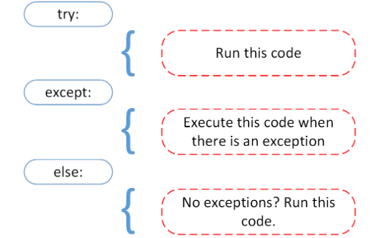
The else Clause

Slide 13
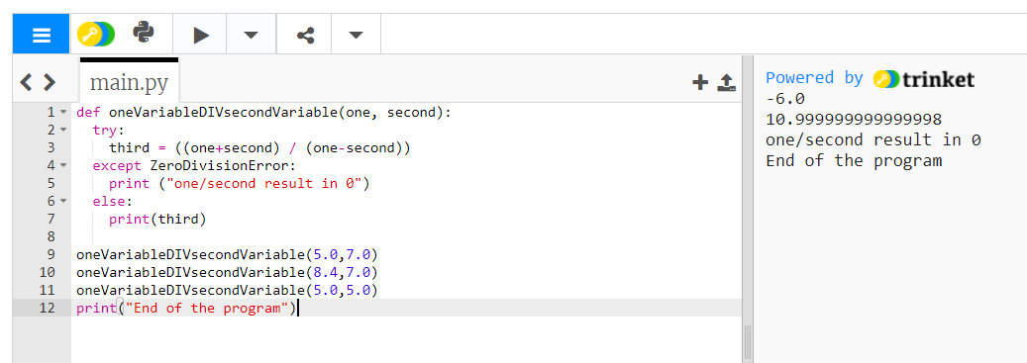
Else Clause: In python, you can also use else clause on try-except block which must be present after all the except clauses. The code enters the else block only if the try clause does not raise an exception.

Slide 14
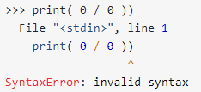
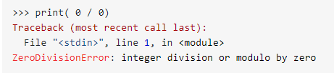
Example: Exceptions versus Syntax Errors
Syntax errors occur when the parser detects an incorrect statement.
This time, you ran into an exception error. This type of error occurs whenever syntactically correct Python code results in an error. The last line of the message indicated what type of exception error you ran into

Slide 15
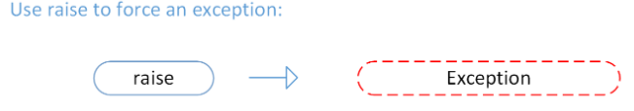
Raising an Exception
We can use raise to throw an exception if a condition occurs. The statement can be complemented with a custom exception.

Slide 16
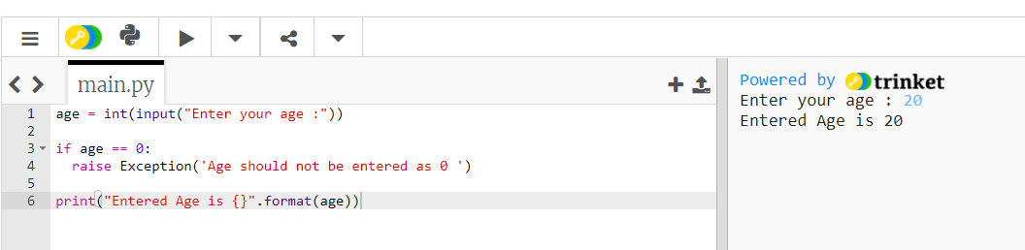
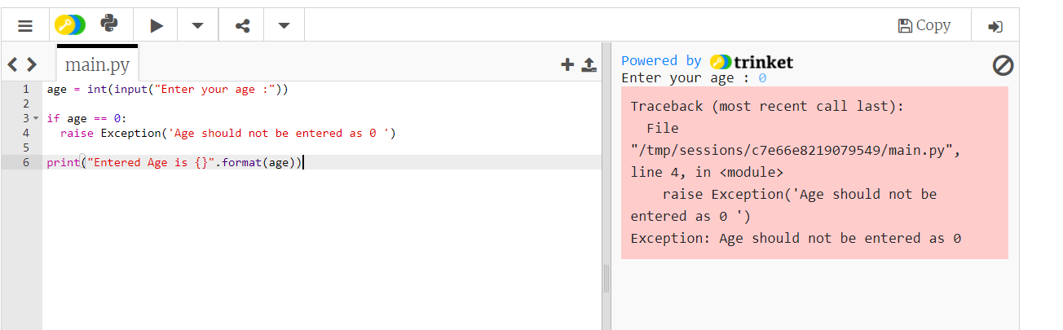
If you want to throw an error when a certain condition occurs using raise, you could go about it like this:

Slide 17
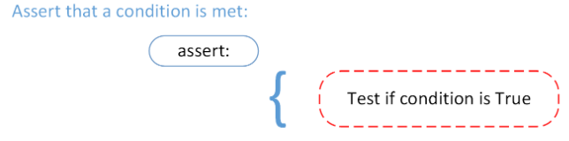
The AssertionError Exception
Instead of waiting for a program to crash midway, you can also start by making an assertion in Python.
We assert that a certain condition is met.
If this condition turns out to be True, then that is excellent! The program can continue.
If the condition turns out to be False, you can have the program throw an AssertionError exception.

Slide 18
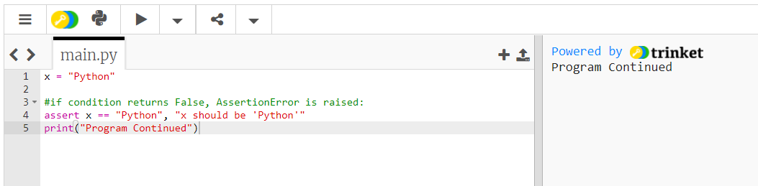
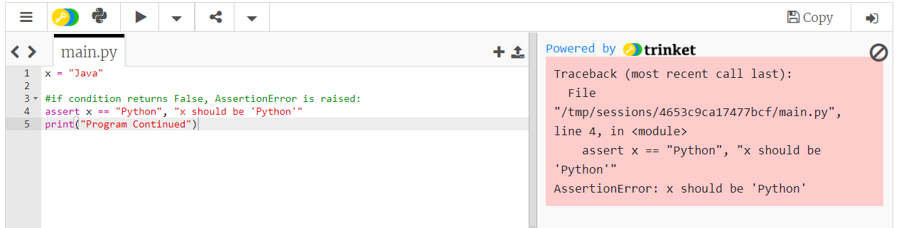
Example
As you saw earlier, when syntactically correct code runs into an error, Python will throw an exception error.
This exception error will crash the program if it is unhandled.
The except clause determines how your program responds to exceptions.

Slide 19
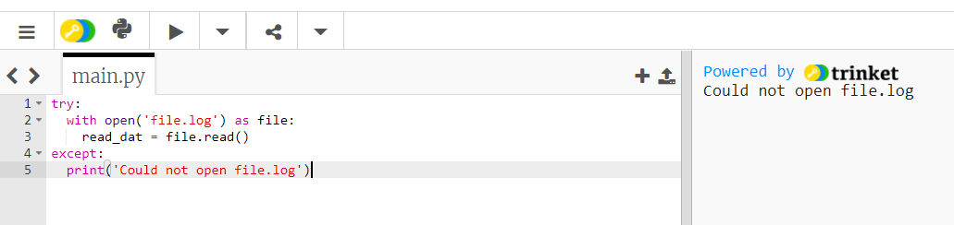
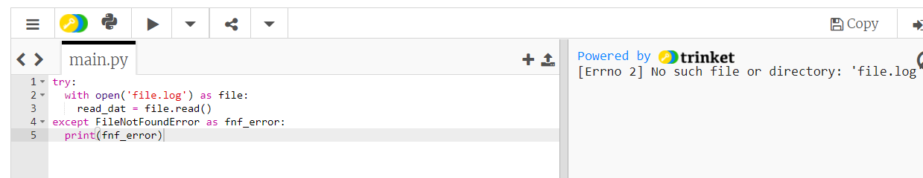
Reading files: Here’s another example where you open a file and use a built-in exception:

